Slide 1





Software Engineering

Slide 2



Sports Club Management System
Introduction

Slide 3
System Description
The sports club management system is a system that stores data and analytics for a sports club and allows for registration and enrollment through an online system.
The objective of this system is to help clubs be more organized and have easier access to data especially for clubs of a larger size.
The system is designed to be user-friendly for both staff and customers.
Notes:
Michael

Slide 4








Why is our system better?
Advantages our system has to existing systems.
Notes:
Michael

Slide 5
Improvement over current systems
The Sports Club Management System is an improvement over paper-based systems because the information recorded can be easily sorted and analyzed, especially if the club being managed is particularly massive.
The online system enables for a much easier data management system where both management and customer can access a range of data from demographic data to payment data.
Notes:
Michael

Slide 6
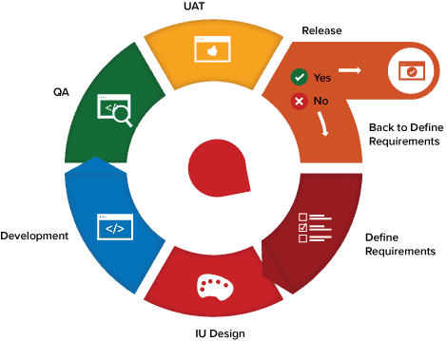
Process Model
Agile Process Flow
Builds a series of features
Decide on tasks to be accomplished for each sprint
Adaptable
Notes:
Michael

Slide 7
Testing Methods
Continuous testing on every function as they were added to detect bugs as early as possible and prevent future errors.
Tested the functions with various different inputs and test cases to ensure the functions would always work appropriately.

Slide 8
How did we gather our requirements?
Different sports coaches
In order to add features for the coaches as well, we asked coaches of different disciplines what they would like to have access to in a management system
1
Current athletes registered in a sports club
To deepen our understanding of what features to implement we also asked athletes that are currently part of sports clubs
2
Personal experience in registration for various sport clubs
At first, team members used their personal experience with paper-based and offline systems to come up with features they wish they had.
3
Notes:
Arb

Slide 9
Functionalities implemented
Athletes can register online
Athletes can enroll and drop classes online
Keeping track of equipment inventory
Athletes can checkout and return equipment online
Produce financial reports
Keeping track of coaches’ and athletes’ schedules
Notes:
Arb

Slide 10
Summary of functionalities
Register as a New Member
Allows players to set up a new account by providing personal details such as name, last name, birthdate, username, password, email, and phone number.
Register/ Drop Class
Allows athletes to register for new classes through the “classes page” on their personal accounts by picking a sport and a time slot. It also allows an athlete to drop a class, if need be.
View Personal Schedule
This function allows coaches and athletes to view their personal schedules through the Classes page on their personal accounts.
Checkout/Return Equipment
Allows athletes to checkout and return equipment through the online portal, in addition to viewing their current checked out equipment.
Update Salary
This function allows administrators to update the salary of a selected coach.
Display Financial Report
Allows an administrator to access a financial report through his/her personal account under the Financial Report page.
Notes:
Arb

Slide 11

Demo Presentation

Slide 12

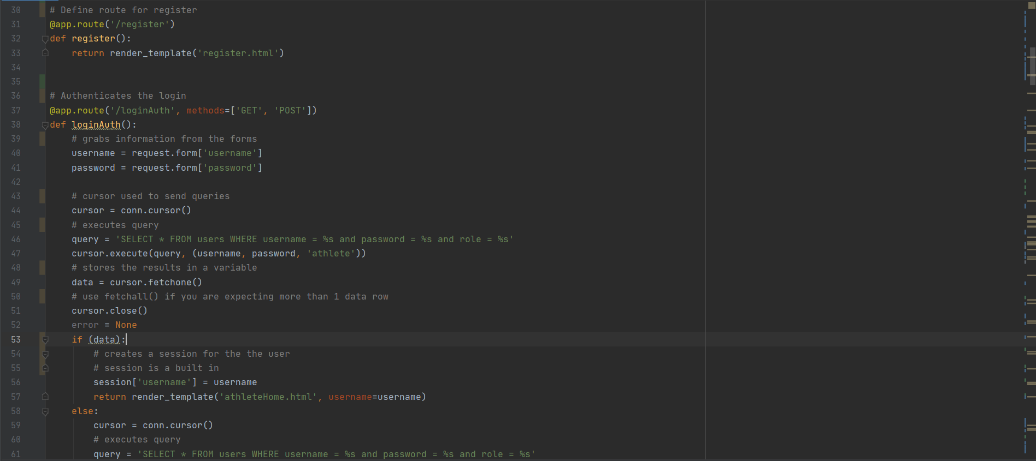
Code Explanation

Slide 13
Future versions
New features to be implemented

Slide 14
Future Functionalities
Make Payment
This function should allow players to make payments upon registering for classes, competitions, or memberships by providing their credit card and personal information.
Register for Competition
The “register for competition” function should allow players to register for competitions through the competitions page in his/her personal accounts.
Display Team Statistics
This function should allow an administrator to access team statistics such as number of total wins, losses, and draws in the current season, and a graph of the number of wins per month.
Notes:
Arb

Slide 15

Thanks!
Authors:
Nour Abdelmoneim, Michael Kwan, Arb Mehmeti, Nahom Molla

